Slide 1
Chapter 8: Single-Area OSPF
Instructor Materials
CCNA Routing and Switching
Scaling Networks v6.0
Notes:
Cisco Networking Academy Program
Scaling Networks v6.0
Chapter 8: Single-Area OSPF

Slide 2
Instructor Materials – Chapter 8 Planning Guide
This PowerPoint deck is divided in two parts:
Instructor Planning Guide
Information to help you become familiar with the chapter
Teaching aids
Instructor Class Presentation
Optional slides that you can use in the classroom
Begins on slide # 17
Note: Remove the Planning Guide from this presentation before sharing with anyone.
Notes:
2

Slide 3
Chapter 8: Single-Area OSPF
Scaling Networks v6.0 Planning Guide
Notes:
Cisco Networking Academy Program
Scaling Networks v6.0
Chapter 8: Single-Area OSPF

Slide 4
Chapter 8: Activities
What activities are associated with this chapter?
Page # | Activity Type | Activity Name | Optional?
8.0.1.2 | Class Activity | Can Submarines Swim? | Optional
8.1.1.6 | Interactive Activity | Identify OSPF Features and Terminology | Recommended
8.1.2.6 | Interactive Activity | Identify the OSPF Packet Types | Recommended
8.1.3.5 | Interactive Activity | Identify the OSPF States for Establishing Adjacency | Recommended
8.1.3.6 | Video | Observing OSPF Protocol Communications | Recommended
8.2.1.2 | Syntax Checker | Entering Router OSPF Configuration Mode on R2 | Recommended
8.2.1.4 | Syntax Checker | Assigning a Router ID | Recommended
8.2.1.5 | Syntax Checker | Modifying the Router ID | Recommended
8.2.2.3 | Syntax Checker | Advertising Networks in OSPF | Recommended
The password used in the Packet Tracer activities in this chapter is: PT_ccna5
Notes:
4

Slide 5
Chapter 8: Activities (Cont.)
What activities are associated with this chapter?
Page # | Activity Type | Activity Name | Optional?
8.2.2.5 | Syntax Checker | Configuring Passive Interfaces | Recommended
8.2.2.6 | Interactive Activity | Calculate the Subnet and Wildcard Masks | Recommended
8.2.2.7 | Packet Tracer | Configuring OSPFv2 in a Single Area | Recommended
8.2.3.5 | Syntax Checker | Adjusting Interface Bandwidths | Recommended
8.2.4.1 | Syntax Checker | Verifying OSPF Neighbors | Recommended
8.2.4.2 | Syntax Checker | Verifying OSPF Protocol Settings | Recommended
8.2.4.3 | Syntax Checker | Verifying OSPF Process Information | Recommended
8.2.4.4 | Syntax Checker | Verifying OSPF Interface Settings | Recommended
8.2.4.5 | Lab | Configuring Basic Single-area OSPFv2 | Optional
The password used in the Packet Tracer activities in this chapter is: PT_ccna5
Notes:
5

Slide 6
Chapter 8: Activities (Cont.)
What activities are associated with this chapter?
Page # | Activity Type | Activity Name | Optional?
8.3.1.5 | Interactive Activity | Compare and Contrast OSPFv2 and OSPFv3 | Recommended
8.3.2.3 | Syntax Checker | Configuring Link-Local Addresses | Recommended
8.3.2.4 | Syntax Checker | Assigning a Router ID | Recommended
8.3.2.5 | Syntax Checker | Modifying the Router ID | Recommended
8.3.2.6 | Syntax Checker | Enabling OSPFv3 on Interfaces | Recommended
8.3.3.1 | Syntax Checker | Verifying OSPFv3 Neighbors | Recommended
8.3.3.2 | Syntax Checker | Verifying OSPFv3 Protocol Settings | Recommended
8.3.3.3 | Syntax Checker | Verifying OSPFv3 Interfaces | Recommended
8.3.3.4 | Syntax Checker | Verifying OSPFv3 Routes | Recommended
The password used in the Packet Tracer activities in this chapter is: PT_ccna5
Notes:
6

Slide 7
Chapter 8: Activities (Cont.)
What activities are associated with this chapter?
Page # | Activity Type | Activity Name | Optional?
8.3.3.5 | Packet Tracer | Configuring Basic OSPFv3 in a Single Area | Optional
8.3.3.6 | Lab | Configuring Basic Single Area OSPFv3 | Recommended
8.4.1.1 | Class Activity | Stepping Through OSPFv3 | Optional
8.4.1.2 | Packet Tracer | Skills Integration Challenge | Recommended
The password used in the Packet Tracer activities in this chapter is: PT_ccna5
Notes:
7

Slide 8
Chapter 8: Assessment
Students should complete Chapter 8, “Assessment” after completing Chapter 8.
Quizzes, labs, Packet Tracers and other activities can be used to informally assess student progress.
Notes:
8

Slide 9
Chapter 8: Best Practices
Prior to teaching Chapter 8, the instructor should:
Complete Chapter 8, “Assessment.”
The objectives of this chapter are:
Explain the features and characteristics of the OSPF routing protocol.
Describe the types of packets used to establish and maintain an OSPF neighbor relationship.
Explain how OSPF achieves convergence.
Configure an OSPF router ID.
Configure single-area OSPFv2.
Explain how OSPF uses cost to determine best path.
Verify single-area OSPFv2.
Compare the characteristics and operations of OSPFv2 to OSPFv3.
Configure single-area OSPFv3.
Verify single-area OSPFv3.
Notes:
9

Slide 10
Chapter 8: Best Practices (Cont.)
Encourage the students to learn OSPF because it is commonly used.
Be sure to emphasize that OSPF is used when the network engineers really understand routing because of the powerfulness and configurability of OSPF.
Describe how in most companies, OSPFv2 is more likely to be seen than OSPFv3. For real-world expectations OSPFv2 is the one to get more familiar with.
Encourage the students to spend a lot of time understanding the concepts in this chapter because multi-area OSPF is very easy if the basics are understood. The same is true for configuration.
When describing the difference between single area and multiarea OSPF, be sure to emphasize that there are more areas normally used than what is shown in the curriculum.
One analogy you might use for the fact that Area 0 is always the backbone area and other areas must connect to it through a border router is to compare it to a daisy or aster flower.
Notes:
10

Slide 11
Chapter 8: Best Practices (Cont.)
You might consider assigning groups packet types discussions before the class lecture and have someone from the group briefly go over section 8.1.2 instead of lecturing on it.
Remind the students that the OSPF protocol is quick to converge once a network change occurs, but initial convergence for all of the routers to get the routing updates takes longer than the protocols they have seen before.
When you get to the OSPF router ID section, remind students that the router ID command has not always been around. Emphasize the order that is used by the router to get the router ID
router-id command
Highest loopback
Highest configured IP address on a particular router
Notes:
11

Slide 12
Chapter 8: Best Practices (Cont.)
Remind students that the router ID is 32 bits long and looks like an IPv4 address even when configured on OSPFv3 for IPv6. The router ID is NOT to be advertised in OSPFv2 with a network statement.
Reinforce that the clear ip ospf process command is used to reset the router ID (rather than rebooting the router).
When teaching configuration, have a simple four or five router scenario on the board and show the configuration for one of them. One router that might be used is the border router that connects to the Internet router. You might consider introducing the static default (quad zero) route on the router and the default-information originate command early. It doesn’t hurt for the students to hear this multiple times.
When writing the configuration for the router on the board, write the two methods of writing the network number side by side.
Notes:
12

Slide 13
Chapter 8: Best Practices (Cont.)
Select another router from the board and have them write the configuration for it.
You might consider having a Packet Tracer that has all the IP addresses assigned and links up and up. You might have the students configure two of the routers for OSPF or have one of them configured already and the students complete the configuration on the second router.
Both the board technique and the Packet Tracer technique can be used for demonstrating OSPFv3.
A tough concept for students to understand is the need to adjust cost for the faster Ethernet links. Bring up the graphic on 8.2.3.3 Figure 1 which shows how a 100 Mbps, 1 Gbps, and 10 Gbps link are all seen as the same cost with the current OSPF configurations.
Emphasize the need for adjusting the reference bandwidth and show 8.2.3.3 Figure 2.
Gigabit Ethernet – auto-cost reference-bandwidth 1000 command
10 Gigabit Ethernet – auto-cost reference-bandwidth 10000 command
Notes:
13

Slide 14
Chapter 8: Best Practices (Cont.)
Write your favorite OSPF troubleshooting commands on the board and why you would use them.
show ip interface brief – see if all links that are being used are up and up. A link cannot be advertised if it is down.
show ip route – see if one router is getting routing updates (has an O before it) from another router. If not, check the other router for the correct network statement.
show ip ospf neighbor – shows whether two adjacent routers have been configured with the correct network statement for the link shared between them.
show ip protocols – see the router ID.
show ip ospf interface - shows details about OSPF on a particular interface.
Notes:
14

Slide 15
Chapter 8: Additional Help
For additional help with teaching strategies, including lesson plans, analogies for difficult concepts, and discussion topics, visit the CCNA Community at: https://www.netacad.com/group/communities/community-home
Best practices from around the world for teaching CCNA Routing and Switching. https://www.netacad.com/group/communities/ccna
If you have lesson plans or resources that you would like to share, upload them to the CCNA Community in order to help other instructors.
Students can enroll in Introduction to Packet Tracer (self-paced).
A good time for students to take the CCENT certification is after taking RSE, but some take it while taking the ScaN course. Students preparing for the CCENT certification, could view the 15 lessons and videos contained at the Cisco Networking/CCENT Wikiversity site: https://en.wikiversity.org/wiki/Cisco_Networking/CCENT
Notes:
15

Slide 17
Chapter 8: Single-Area OSPF
CCNA Routing and Switching
Scaling Networks v6.0
Notes:
Cisco Networking Academy Program
Scaling Networks v6.0
Chapter 8: Single-Area OSPF

Slide 18
Chapter 3 - Sections & Objectives
8.1 OSPF Operation
Explain how single-area OSPF operates.
Explain the features and characteristics of the OSPF routing protocol.
Describe the types of packets used to establish and maintain an OSPF neighbor relationship.
Explain how OSPF achieves convergence.
8.2 Varieties of Spanning Tree Protocols
Implement single-area OSPFv2.
Configure an OSPF router ID.
Configure single-area OSPFv2.
Explain how OSPF uses cost to determine best path.
Verify single-area OSPFv2.
Notes:
18
Cisco Networking Academy Program
Scaling Networks v6.0
Chapter 8: Single-Area OSPF

Slide 19
Chapter 8 - Sections & Objectives (Cont.)
8.3 Implement single-area OSPFv3
Compare the characteristics and operations of OSPFv2 to OSPFv3.
Configure single-area OSPFv3.
Verify single-area OSPFv3.
Notes:
19
Cisco Networking Academy Program
Scaling Networks v6.0
Chapter 8: Single-Area OSPF

Slide 20
8.1 OSPF Characteristics
Notes:
8 – Single-Area OSPF
8.1 – OSPF Characteristics

Slide 21
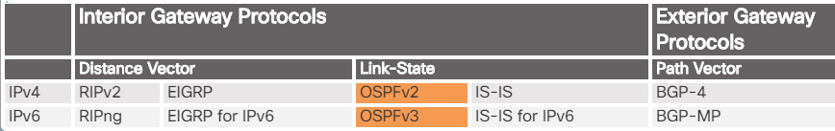
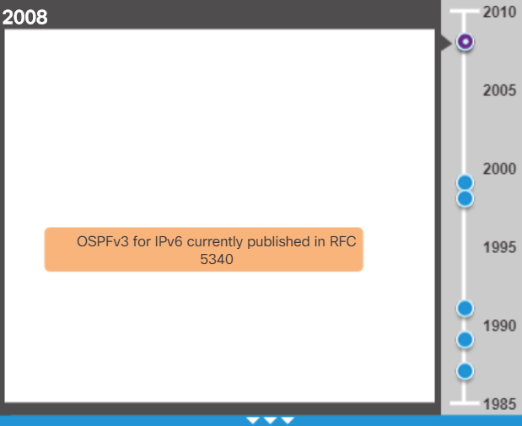
Open Shortest Path First Evolution of OSPF
OSPF is a link-state routing protocol
1999 OSPFv3 for IPv6 published in RFC 2740
1998 OSPFv2 updated in RFC 2328
1991 OSPFv2 introduced in RFC 1247
1989 OSPFv1 published in RFC 1131
1988 development work begins on OSPF
Notes:
8.1 –OSPF Characteristics
8.1.1 – Open Shortest Path First
8.1.1.1 – Evolution of OSPF

Slide 22
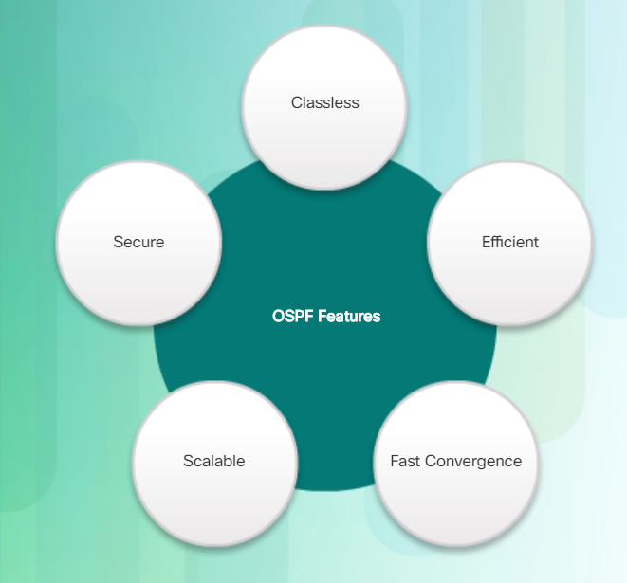
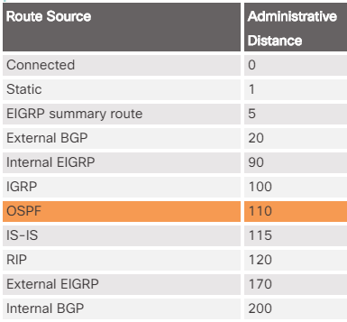
Open Shortest Path First Features of OSPF
v2 supports MD5 and SHA authentication
v3 uses IPsec for authentication
Routing changes trigger routing updates
Supports a hierarchical design system through the use of areas
OSPF uses the Dijkstra shortest path first (SPF) algorithm to choose the best path.
Administrative distance is used in determining what route gets installed in the routing table when the route is learned from multiple sources.
The lowest administrative distance is the one added to the routing table.
Notes:
8.1 –OSPF Characteristics
8.1.1 – Open Shortest Path First
8.1.1.2 – Features of OSPF

Slide 23
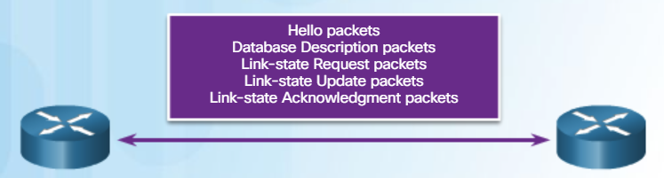
Open Shortest Path First Components of OSPF
Database | Table | Description
Adjacency | Neighbor | Lists all neighbor routers to which a router has established bidirectional communication Unique for each router View using the show ip ospf neighbor command
Link-state (LSDB) | Topology | Lists information about all other routers Represents the network topology Contains the same LSDB as all other routers in the same area View using the show ip ospf database command
Forwarding | Routing | Lists routes generated when the SPF algorithm is run on the link-state database. Unique to each router and contains information on how and where to send packets destined for remote networks View using the show ip route command
OSPF packet types: hello, database description, link-state request, link-state update, link-state acknowledgment
Notes:
8.1 –OSPF Characteristics
8.1.1 – Open Shortest Path First
8.1.1.3 – Components of OSPF

Slide 24
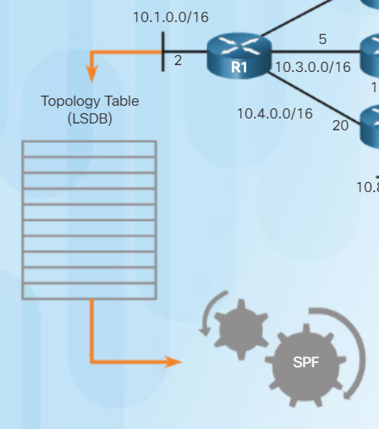
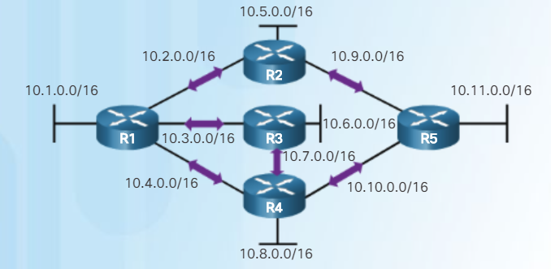
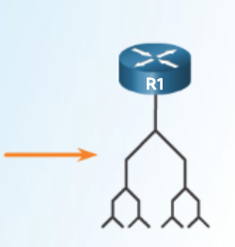
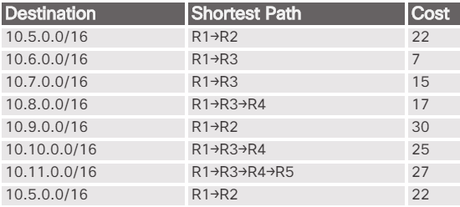
Open Shortest Path First Link-State Operation
3
Each router builds a topology table
4/5
Each router runs the SPF algorithm resulting in the SPF tree
1
Use hello packets to establish neighbor adjacencies
2
Use LSAs to flood the area with cost and state of links
6
Each router builds a routing table that includes the path to get to the distant network and the cost to get there.
Notes:
8.1 –OSPF Characteristics
8.1.1 – Open Shortest Path First
8.1.1.4 – Link-State Operation

Slide 25
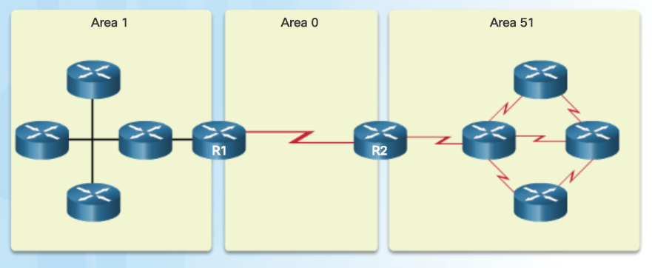
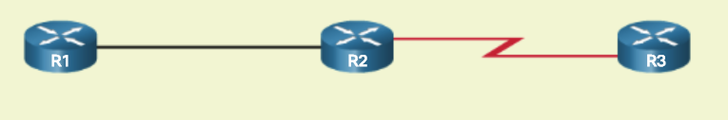

Open Shortest Path First Single-Area and Multiarea OSPF
Multiarea OSPF
Single-Area OSPF
All routers contained in one area
Called the backbone area
Known as Area 0
Used in smaller networks with few routers
Designed using a hierarchical scheme
All areas connect to area 0
More commonly seen with numerous areas around area 0 (like a daisy or aster)
Routers that connect area 0 to another area is known as an Area Border Router (ABR)
Used in large networks
Multiple areas reduces processing and memory overhead
A failure in one area does not affect other areas
The original uploader was Hugowolf at English Wikipedia - Transferred from en.wikipedia to Commons by DieBuche using CommonsHelper., CC BY-SA 3.0, https://commons.wikimedia.org/w/index.php?curid=10285606
Notes:
8.1 –OSPF Characteristics
8.1.1 – Open Shortest Path First
8.1.1.5 – Single-Area and Multiarea OSPF

Slide 26



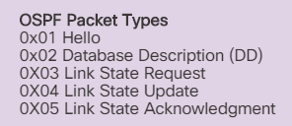

OSPF Messages Encapsulating OSPF Messages
OSPF adds its own Layer 3 header after the IP Layer 3 header.
The IP header contains the OSPF multicast address of either 224.0.0.5 or 224.0.0.6 and the protocol field of 89 which indicates it is an OSPF packet.
OSPF Packet Header identifies the type of OSPF packet, the router ID, and the area ID
OSPF Packet Type contains the specific OSPF packet type information
Notes:
8.1 –OSPF Characteristics
8.1.2 – OSPF Messages
8.1.2.1 – Encapsulating OSPF Messages

Slide 27
OSPF Messages Encapsulating OSPF Messages (Cont.)
OSPFv3 has similar packet types.
OSPF Packet Type | Packet Name | Description
1 | Hello | Discovers neighbors and builds adjacencies between them
2 | Database Description (DBD) | Checks for database synchronization between routers
3 | Link-State Request (LSR) | Requests specific link-state records from router to router
4 | Link-State Update (LSU) | Sends specifically requested link-state records
5 | Link-State Acknowledgment (LSAck) | Acknowledges the other packet types
Notes:
8.1 –OSPF Characteristics
8.1.2 – OSPF Messages
8.1.2.1 – Encapsulating OSPF Messages

Slide 28
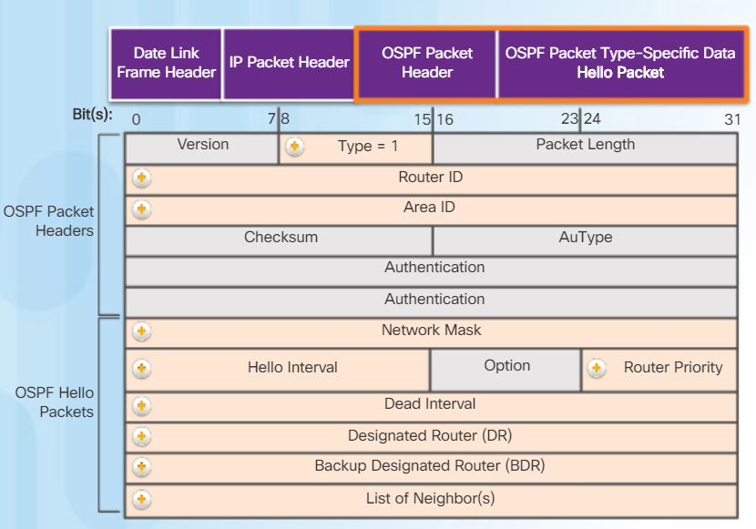
OSPF Messages Hello Packet
Hello packets are used to discover neighbors, establish neighbor adjacencies, advertise parameters both routers must agree upon in order to become neighbors, and elect the Designated Router (DR) and Backup Designated Router (BDR) on multi-access networks like Ethernet and Frame Relay (not serial point-to-point links).
Type field – 1 = hello; 2 = DBD; 3 = LSR; 4 = LSU; 5 - LSAck
Hello interval – how often a router sends hello packets
Router priority (default is 1; 0-255 with the higher number influencing the DR/BDR election process)
Dead interval – how long a router waits to hear from a neighbor router before declaring the router out of service
DR and BDR fields contain the router ID for the DR and BDR
List of neighbors is the router ID for all adjacent neighbor routers
Notes:
8.1 –OSPF Characteristics
8.1.2 – OSPF Messages
8.1.2.3 – Hello Packet

Slide 29
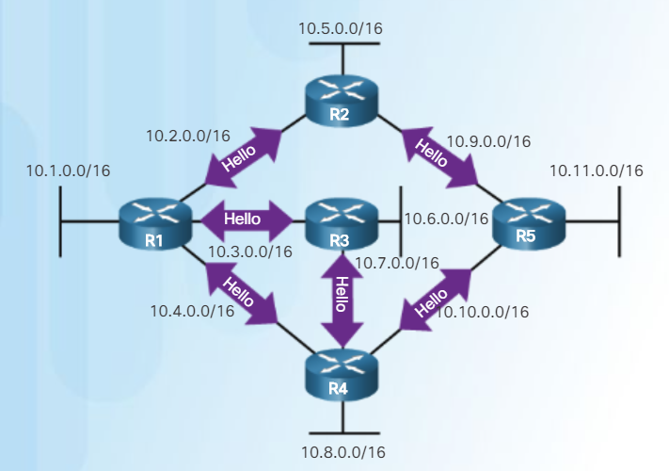
OSPF Messages Hello Packet Intervals
Hello and dead intervals must be the same interval setting on neighboring routers on the same link
Transmitted to multicast address 224.0.0.5 in IPv4
Transmitted to multicast address FF02::5 in IPv6
Sent every 10 seconds by default on multi-access networks like Ethernet and point-to-point links
Sent every 30 seconds by default on non-broadcast multiple access networks (NBMA) like Frame Relay
Dead intervals by default are 4 times the hello interval
If the dead interval expires before the router receives a hello packet, OSPF removes that neighbor from its link state data base (LSDB). The router then floods the LSDB with info about the down neighbor.
Notes:
8.1 –OSPF Characteristics
8.1.2 – OSPF Messages
8.1.2.4 – Hello Packet Intervals

Slide 30
OSPF Messages Link-State Updates
A Link State Update (LSU) contains one or more LSAs; LSAs contain route information for destination networks
Routers initially send Type 2 DBD packets – an abbreviated list of the sending routers LSDB
Receiving routers check against their own LSDB
Type 3 LSR is used by the receiving router to request more information about an entry in the Database Description (DBD)
Type 4 Link-state Update (LSU) is used to reply to an LSR packet
LSA Type | Description
1 | Router LSAs
2 | Network LSAs
3 or 4 | Summary LSAs
5 | Autonomous System External LSAs
6 | Multicast OSPF LSAs
7 | Defined for Not-So-Stubby Areas
8 | External Attributes LSA for Border Gateway Protocol (BGP)
9, 10, 11 | Opaque LSAs
OSPF Packet Type | Packet Name | Description
1 | Hello | Discovers neighbors and builds adjacencies between them
2 | DBD | Checks for database synchronization between routers
3 | LSR | Requests specific link-state records from router to router
4 | Link-State Update (LSU) | Sends specifically requested link-state records
5 | LSAck | Acknowledges the other packet types
Notes:
8.1 –OSPF Characteristics
8.1.2 – OSPF Messages
8.1.2.5 – Link-State Updates

Slide 31
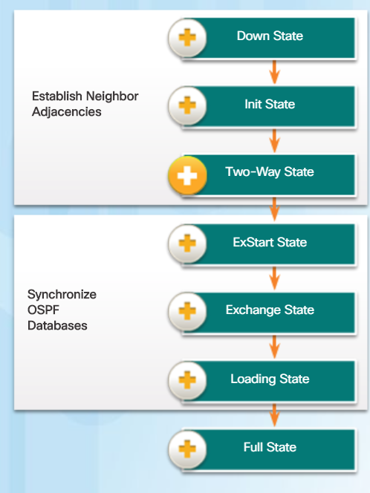
OSPF Operation OSPF Operational States
OSPF progresses through several states while attempting to reach convergence:
Down – No Hello packets received; router sends Hello packets
Init – Hello packets are received that contain the sending router’s Router ID
Two-Way – Used to elect a DR and BDR on an Ethernet link
ExStart – Negotiate master/slave relationship and DBD packet sequence number; the master initiates the DBD packet exchange
Exchange – Routers exchange DBD packets; if additional router information is required, then transition to the Loading State, otherwise, transition to the Full State
Loading – LSRs and LSUs are used to gain additional route information; routes are processed using the shortest path first (SPF) algorithm; transition to the Full State
Full – Routers have converged databases
Notes:
8.1 –OSPF Characteristics
8.1.3 – OSPF Operation
8.1.3.1 – OSPF Operational States

Slide 32
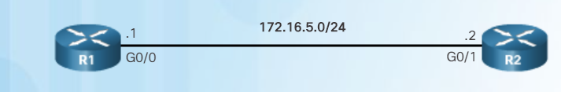
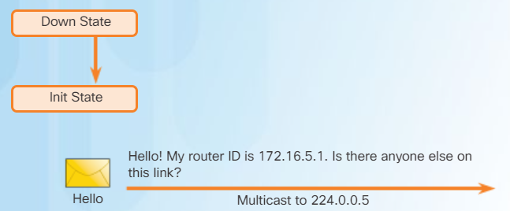
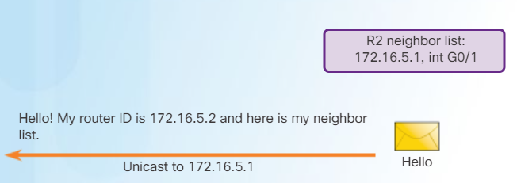
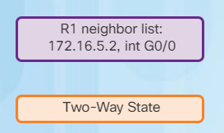
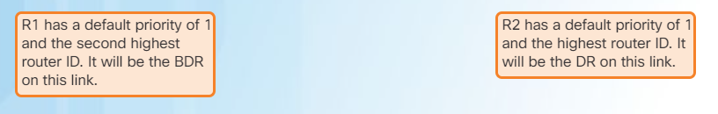
OSPF Operation Establish Neighbor Adjacencies
Without a pre-configured router ID (RID) or loopback addresses, R1 has a RID of 172.16.5.1 and R2 has a RID of 172.16.5.2
1
2
Init State
3
Elect the DR and BDR
4
Notes:
8.1 –OSPF Characteristics
8.1.3 – OSPF Operation
8.1.3.2 – Establish Neighbor Adjacencies

Slide 33
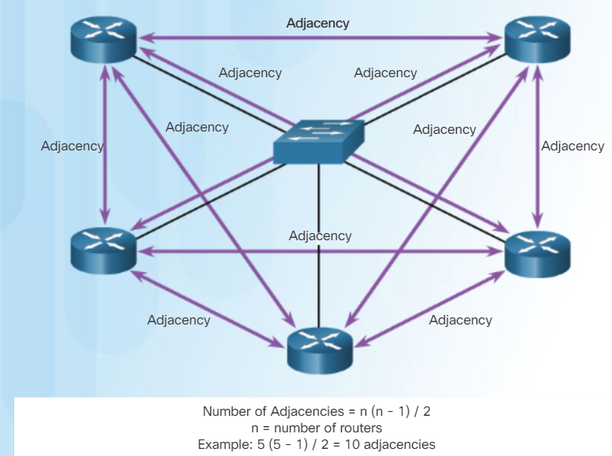
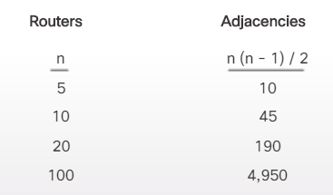
OSPF Operation OSPF DR and BDR
Why have a DR/BDR election?
Reduce the number of LSAs sent – The DR is the only router used to send LSAs for the shared network
Reduce the number of adjacencies over a multi-access network like Ethernet
Notes:
8.1 –OSPF Characteristics
8.1.3 – OSPF Operation
8.1.3.3 – OSPF DR and BDR

Slide 34
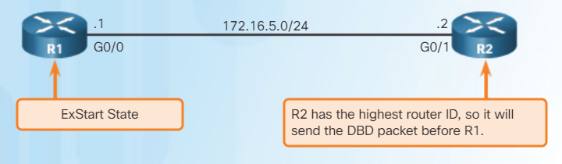
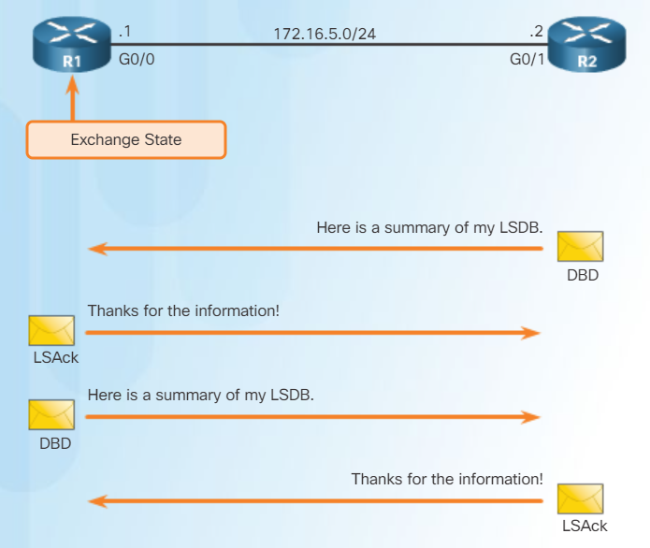
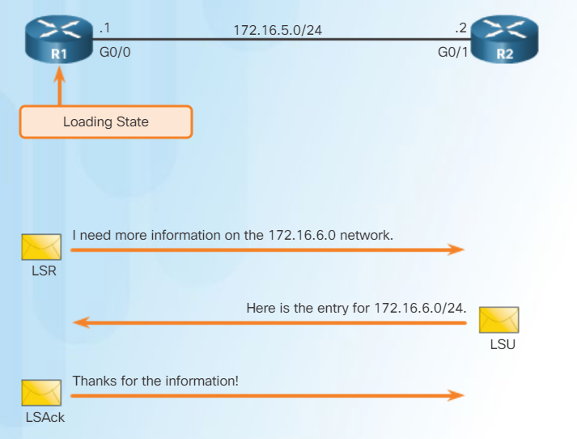
OSPF Operation Synchronizing OSPF Databases
1
After the Two-Way state, routers need to synchronize their databases and use the other four types of OSPF packets to exchange information.
2
3
Notes:
8.1 –OSPF Characteristics
8.1.3 – OSPF Operation
8.1.3.4 – Synchronizing OSPF Databases

Slide 35
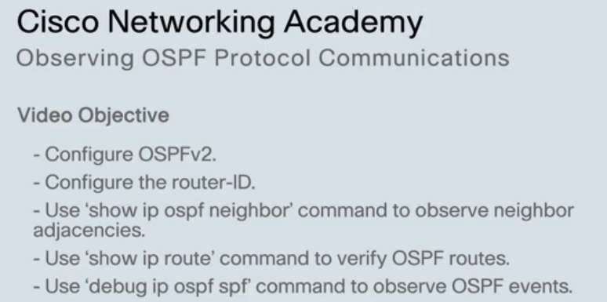
OSPF Operation Video Demonstration – Observing OSPF Protocol Communications
Notes:
8.1 –OSPF Characteristics
8.1.3 – OSPF Operation
8.1.3.4 – Synchronizing OSPF Databases

Slide 36
8.2 Single-Area OSPFv2
Notes:
8 – Single-Area OSPF
8.2 – Single-Area OSPFv2

Slide 37
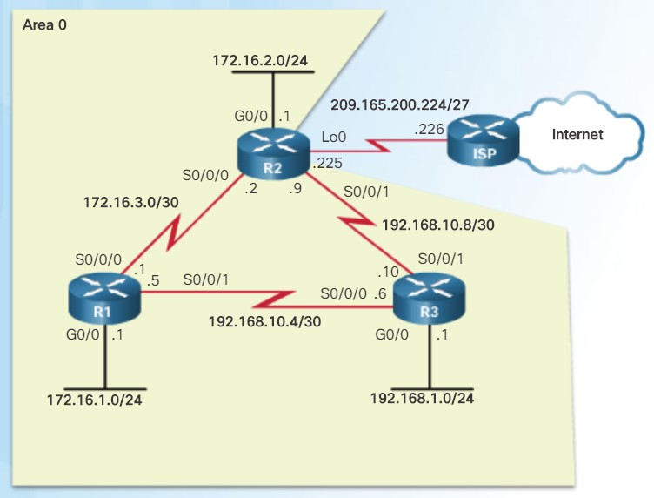
OSPF Router ID OSPF Network Topology
Topology used to describe OSPF configuration
Notes:
8.2 – Single-Area OSPFv2
8.2.1 – OSPF Router ID
8.2.1.1 – OSPF Network Topology

Slide 38
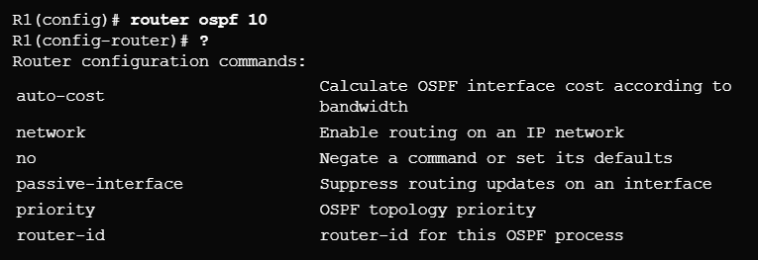
OSPF Router ID Router OSPF Configuration Mode
OSPFv2 configuration uses the router ospf configuration mode
From global configuration mode, type router ospf process-id to enter commands
Note there are other commands used in this mode.
Notes:
8.2 – Single-Area OSPFv2
8.2.1 – OSPF Router ID
8.2.1.2 – Router OSPF Configuration Mode

Slide 39
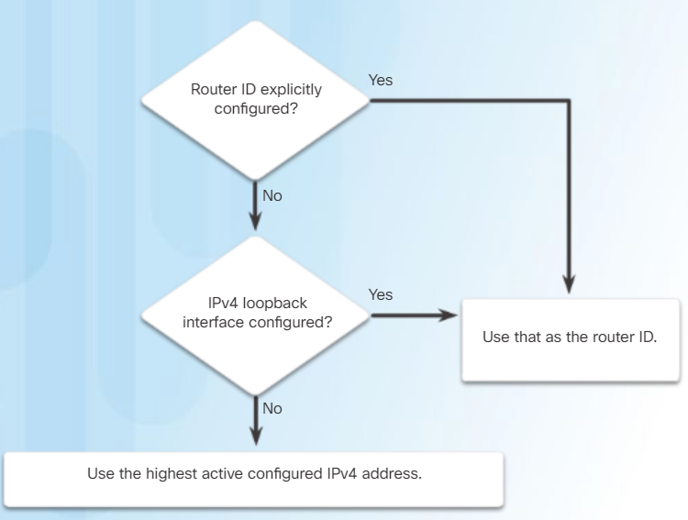
OSPF Router ID Router IDs
Router IDs are used to uniquely identify an OSPF router
Router IDs are 32 bits long in both OSPFv2 (IPv4) and OSPFv3 (IPv6)
Used in the election of the DR if a priority number is not configured
Ways a router gets a router ID
Configured using the router-id rid OSPF router configuration mode command
If a router ID is not configured, the highest configured loopback interface is used
If there are no configured loopback interfaces, then the highest active IPv4 address is used (not recommended because if the interface with the highest IPv4 address goes down, the router ID selection process starts over)
If a loopback address is used, do not route this network using a network statement!
Notes:
8.2 – Single-Area OSPFv2
8.2.1 – OSPF Router ID
8.2.1.3 – Router IDs

Slide 40
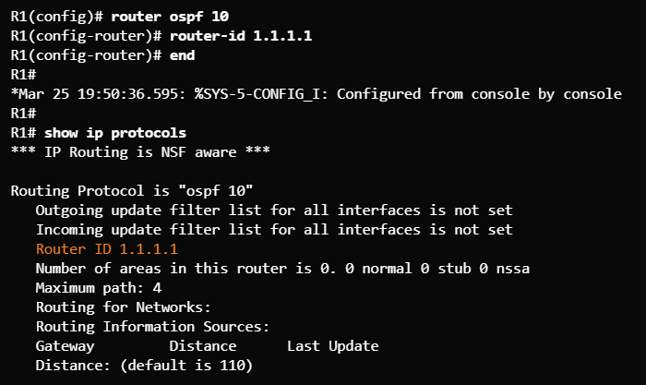
OSPF Router ID Configuring an OSPF Router ID
Use the router-id x.x.x.x command to configure a router ID.
Use the show ip protocols command to verify the router ID.
Notes:
8.2 – Single-Area OSPFv2
8.2.1 – OSPF Router ID
8.2.1.4 – Configuring an OSPF Router ID

Slide 41
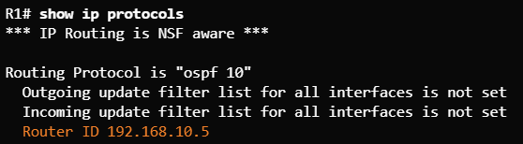
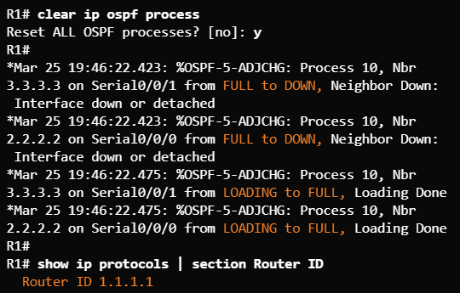

OSPF Router ID Modifying a Router ID
Don’t forget this command to make the router ID change effective.
Use the clear ip ospf process command after changing the router ID to make the change effective.
Original RID
Change RID
Applied RID Change
Notes:
8.2 – Single-Area OSPFv2
8.2.1 – OSPF Router ID
8.2.1.5 – Modifying a Router ID

Slide 42
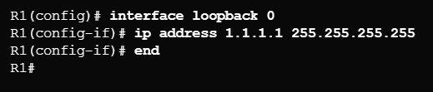
OSPF Router ID Using a Loopback Interface as the Router ID
Do NOT advertise this network! It is a common mistake made in OSPF configurations.
Older IOS version did not have the router-id OSPF configuration command.
Loopback interfaces were used to provide a stable router ID.
Notes:
8.2 – Single-Area OSPFv2
8.2.1 – OSPF Router ID
8.2.1.6 – Using a Loopback Interface as the Router ID

Slide 43
Configuring Single-Area OSPFv2 Enabling OSPF on Interfaces
Use the network command to specify which interface(s) participate in the OSPFv2 area.
(config)# router ospf x
(config-router)# network x.x.x.x wildcard_mask area area-id
Common misconception!
R2 has 3 interfaces in Area 0 so three network statements are used (not 6 network statements for all 6 networks in the entire area)
If a single-area topology is used, it is best to use Area 0
Notes:
8.2 – Single-Area OSPFv2
8.2.2 – Configuring Single-Area OSPFv2
8.2.2.1 – Enabling OSPF on Interfaces

Slide 44
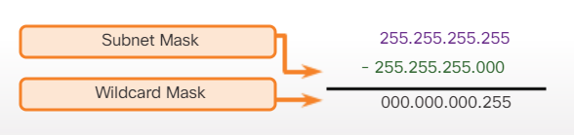
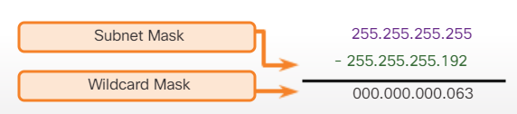
Configuring Single-Area OSPFv2 Wildcard Mask
To determine the wildcard mask, subtract the normal mask from 255.255.255.255
A wildcard mask bit of 0 – match the bit
A wildcard mask bit of 1 – ignore the bit
A wildcard mask is a series of 0s with the rest 1s (the 0s and 1s are not alternating like an IP address)
/24 mask
/26 mask
Notes:
8.2 – Single-Area OSPFv2
8.2.2 – Configuring Single-Area OSPFv2
8.2.2.2 – Wildcard Mask

Slide 45


Configuring Single-Area OSPFv2 The network Command
Two ways to use the network command
Advertise the particular network, calculating the wildcard mask
Advertise the IP address on the router interface with a 0.0.0.0 wildcard mask
Method 1 Traditional Method Network Number and Wildcard Mask
Method 2 Interface IP Address and 0.0.0.0
Some students find this method easier so the wildcard mask does not have to be calculated.
Notes:
8.2 – Single-Area OSPFv2
8.2.2 – Configuring Single-Area OSPFv2
8.2.2.3 – The network Command

Slide 46
Configuring Single-Area OSPFv2 Passive Interface
An interface configured as a passive interface does not SEND OSPF messages.
Best practice for interfaces that have users attached (security)
Doesn’t waste bandwidth sending messages out OSPF-enabled interfaces that don’t have another router attached.
Interfaces to configure as a passive interface
Notes:
8.2 – Single-Area OSPFv2
8.2.2 – Configuring Single-Area OSPFv2
8.2.2.4 – Passive Interface

Slide 47
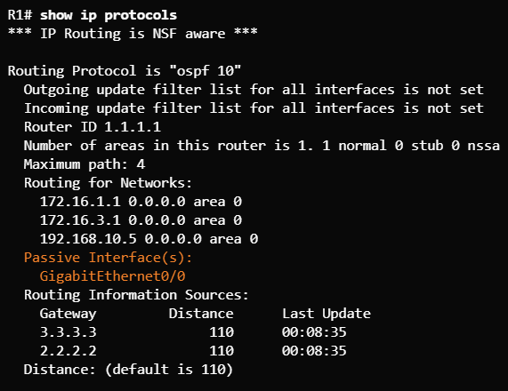
Configuring Single-Area OSPFv2 Configuring Passive Interfaces
Use the passive-interface command to configure
Use the show ip protocols to verify
Notes:
8.2 – Single-Area OSPFv2
8.2.2 – Configuring Single-Area OSPFv2
8.2.2.5 – Configuring Passive Interfaces

Slide 48
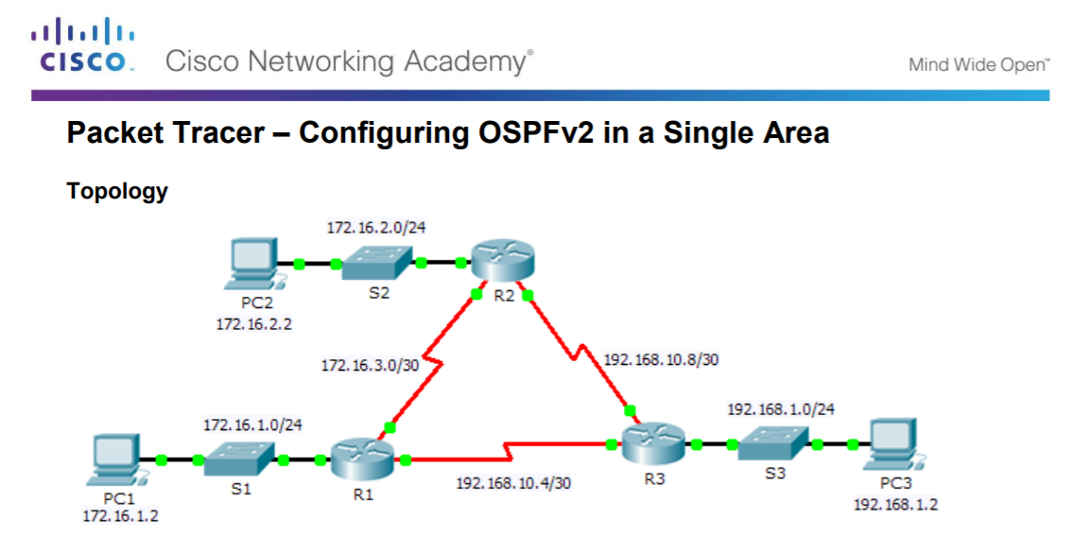
Configuring Single-Area OSPFv2 Packet Tracer – Configuring OSPFv2 in a Single-Area
Notes:
8.2 – Single-Area OSPFv2
8.2.2 – Configuring Single-Area OSPFv2
8.2.2.7 – Packet Tracer – Configuring OSPFv2 in a Single-area

Slide 49
OSPF Cost OSPF Metric = Cost
OSPF uses the metric of cost to determine the best path used to reach a destination network (Cost = reference bandwidth / interface bandwidth)
Lowest cost is a better path
The interface bandwidth influences the cost assigned
A lower bandwidth interface has a higher cost
Important Concept!
Interface Type | Reference Default Bandwidth in bps Bandwidth in bps | Cost
10 Gbps Ethernet | 100,000,000 ÷ 10,000,000,000 | 1
1 Gbps Ethernet | 100,000,000 ÷ 1,000,000,000 | 1
100 Mbps Ethernet | 100,000,000 ÷ 100,000,000 | 1
10 Mbps Ethernet | 100,000,000 ÷ 10,000,000 | 10
1.544 Mbps Serial | 100,000,000 ÷ 1,544,000 | 64
128 kbps Serial | 100,000,000 ÷ 128,000 | 781
64 kbps Serial | 100,000,000 ÷ 64,000 | 1562
This is an issue because it is the same cost due to the default reference bandwidth. Needs to be adjusted!
Notes:
8.2 – Single-Area OSPFv2
8.2.3 – OSPF Cost
8.2.3.1 – OSPF Metric = Cost

Slide 50
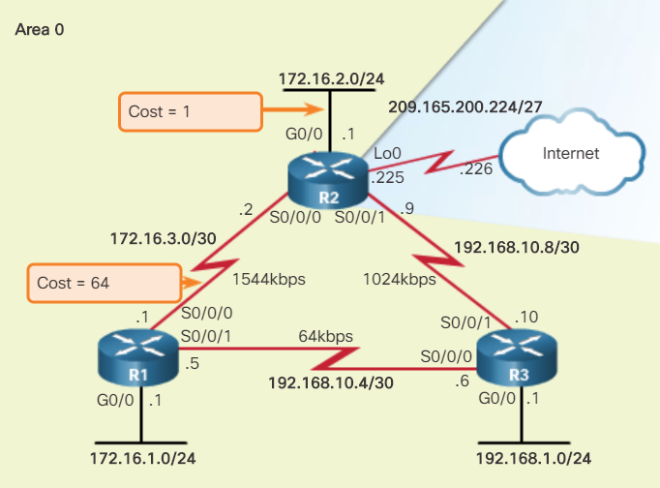
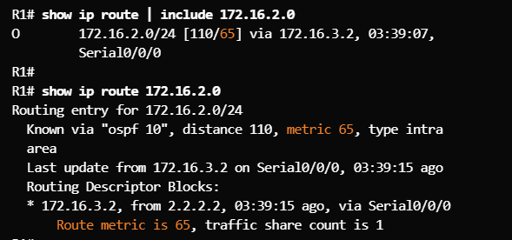
OSPF Cost OSPF Accumulates Costs
The “cost” for a destination network is an accumulation of all cost values from source to destination.
The cost metric can be seen in the routing table as the second number within the brackets.
Cost metric to destination network 172.16.2.0 from R1
Total cost to reach R2 LAN from R1 = 65
Notes:
8.2 – Single-Area OSPFv2
8.2.3 – OSPF Cost
8.2.3.2 – OSPF Accumulates Costs

Slide 51
OSPF Cost Adjusting the Reference Bandwidth
Changing the OSPF reference bandwidth affects only the OSPF calculation used to determine the metric, not the bandwidth of the interface.
Use the auto-cost reference-bandwidth command to change the OSPF reference bandwidth.
Default reference bandwidth is 100 Mbps.
Interface Type | Reference Default Bandwidth in bps Bandwidth in bps | Cost
10 Gbps Ethernet | 100,000,000 ÷ 10,000,000,000 | 1
1 Gbps Ethernet | 100,000,000 ÷ 1,000,000,000 | 1
100 Mbps Ethernet | 100,000,000 ÷ 100,000,000 | 1
10 Mbps Ethernet | 100,000,000 ÷ 10,000,000 | 10
1.544 Mbps Serial | 100,000,000 ÷ 1,544,000 | 64
128 kbps Serial | 100,000,000 ÷ 128,000 | 781
64 kbps Serial | 100,000,000 ÷ 64,000 | 1562
With the default reference bandwidth applied makes 100Mbps Ethernet, 1 Gbps Ethernet, and 10 Gbps Ethernet appear to be the same bandwidth within the best path calculations.
Notes:
8.2 – Single-Area OSPFv2
8.2.3 – OSPF Cost
8.2.3.3 – Adjusting the Reference Bandwidth

Slide 52
OSPF Cost Adjusting the Reference Bandwidth (Cont.)
To adjust to distinguish between 100 Mbps Ethernet and Gigabit Ethernet, use the auto-cost reference-bandwidth 1000 command.
To adjust to distinguish between 100 Mbps Ethernet and Gigabit Ethernet, use the auto-cost reference-bandwidth 10000 command.
Interface Type | Reference Default Bandwidth in bps Bandwidth in bps | Cost
10 Gbps Ethernet | 1,000,000,000 ÷ 10,000,000,000 | 1
1 Gbps Ethernet | 1,000,000,000 ÷ 1,000,000,000 | 1
100 Mbps Ethernet | 1,000,000,000 ÷ 100,000,000 | 10
10 Mbps Ethernet | 1,000,000,000 ÷ 10,000,000 | 100
1.544 Mbps Serial | 1,000,000,000 ÷ 1,544,000 | 647
128 kbps Serial | 1,000,000,000 ÷ 128,000 | 7812
64 kbps Serial | 1,000,000,000 ÷ 64,000 | 15625
Interface Type | Reference Default Bandwidth in bps Bandwidth in bps | Cost
10 Gbps Ethernet | 10,000,000,000 ÷ 10,000,000,000 | 1
1 Gbps Ethernet | 10,000,000,000 ÷ 1,000,000,000 | 10
100 Mbps Ethernet | 10,000,000,000 ÷ 100,000,000 | 100
10 Mbps Ethernet | 10,000,000,000 ÷ 10,000,000 | 1000
1.544 Mbps Serial | 110,000,000,000 ÷ 1,544,000 | 6477
128 kbps Serial | 10,000,000,000 ÷ 128,000 | 78126
64 kbps Serial | 10,000,000,000 ÷ 64,000 | 156250
auto-cost reference-bandwidth 1000 command applied
auto-cost reference-bandwidth 10000 command applied
Notes:
8.2 – Single-Area OSPFv2
8.2.3 – OSPF Cost
8.2.3.3 (Cont.) – Adjusting the Reference Bandwidth

Slide 53
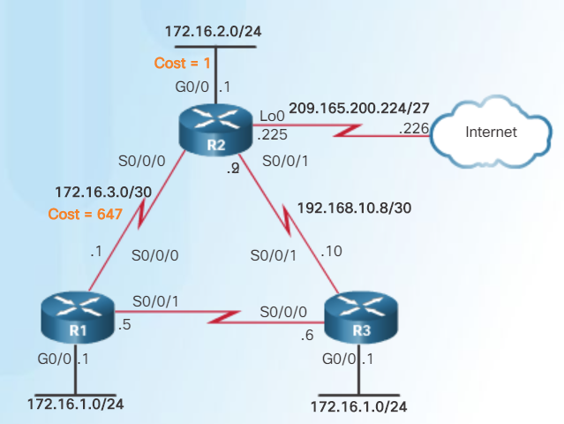
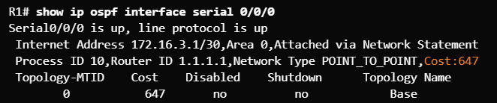
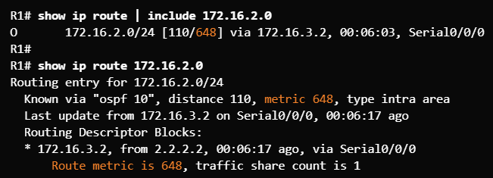
OSPF Cost Adjusting the Reference Bandwidth (Cont.)
If the routers in the topology are adjusted to accommodate Gigabit links, the cost of the serial link is now 647 instead of 64. The total cost from R1 to the R2 LAN is now 648 instead of 65.
If there were FastEthernet links in the topology, OSPF would make better choices.
Total cost to reach R2 LAN from R1 = 648
Notes:
8.2 – Single-Area OSPFv2
8.2.3 – OSPF Cost
8.2.3.3 (Cont.) – Adjusting the Reference Bandwidth

Slide 54
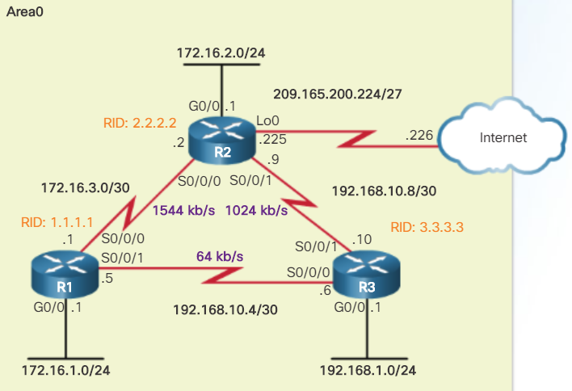
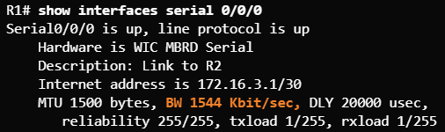
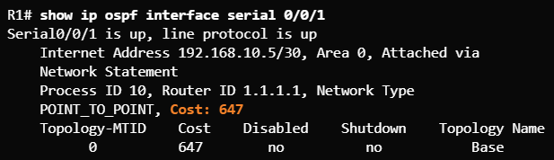

OSPF Cost Default Interface Bandwidth
Bandwidth values defined on an interface do not change the capacity of the interface.
Bandwidth values defined on an interface are used by the EIGRP and OSPF routing protocols to compute the metric.
Serial links default to 1.544 Mbps and that might not be an accurate bandwidth for the transmission rate.
Use the show interfaces command to see the interface bandwidth..
Notes:
8.2 – Single-Area OSPFv2
8.2.3 – OSPF Cost
8.2.3.4 – Default Interface Bandwidth

Slide 55
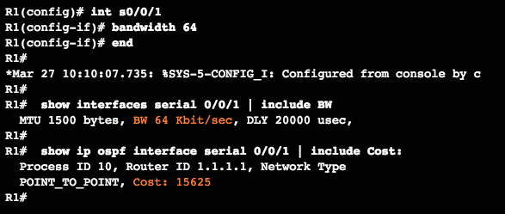
OSPF Cost Adjusting the Interface Bandwidth
The bandwidth must be adjusted at each end of the serial links, therefore:
R2 requires its S0/0/1 interface to be adjusted to 1,024 kb/s.
R3 requires its serial 0/0/0 to be adjusted to 64 kb/s and its serial 0/0/1 to be adjusted to 1,024 kb/s.
Note: Command only modifies OSPF bandwidth metric. Does not modify the actual link bandwidth.
Notes:
8.2 – Single-Area OSPFv2
8.2.3 – OSPF Cost
8.2.3.5 – Adjusting the Interface Bandwidth

Slide 56
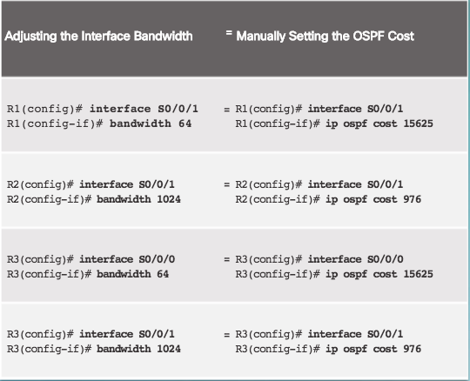
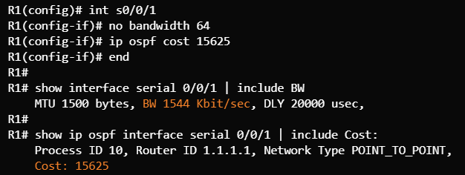
OSPF Cost Manually Setting the OSPF Cost
Instead of manually setting the interface bandwidth, the OSPF cost can be manually configured using the ip ospf cost value interface configuration mode command.
The no bandwidth 64 is used to remove the command that was previously applied and reset the bandwidth back to the default.
Notes:
8.2 – Single-Area OSPFv2
8.2.3 – OSPF Cost
8.2.3.6 – Manually Setting the OSPF Cost

Slide 57
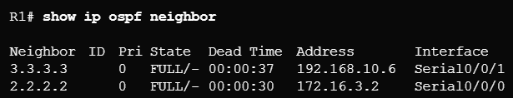
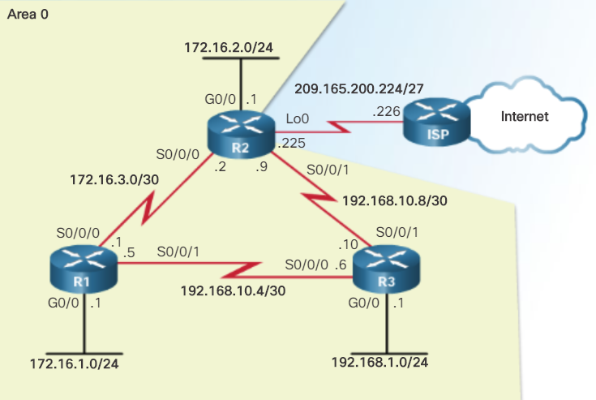
Verify OSPF Verify OSPF Neighbors
Use the show ip ospf neighbor to verify the router has formed an adjacency with a directly-connected router.
Output | Description
Neighbor ID | The router ID of the neighbor router
Pri | The OSPFv2 priority of the interface used in the DR/BDR election process
State | The OSPFv2 state – Full means that the link-state database has had the algorithm executed and the neighbor router and R1 have identical LSDBs. Ethernet multi-access interfaces may show as 2WAY. The dash indicates that no DR/BDR is required.
Dead time | Amount of time remaining before expecting to receive a hello packet from the neighbor before declaring the neighbor down. This value is reset when a hello packet is received.
Address | The address of the neighbor’s directly-connected interface
Interface | The interface on R1 used to form an adjacency with the neighbor router
Notes:
8.2 – Single-Area OSPFv2
8.2.4 – Verify OSPF
8.2.4.1 – Verify OSPF Neighbors

Slide 58

Verify OSPF Verify OSPF Protocol Settings
The show ip protocols command is used to verify the OSPFv2 process ID, router ID, networks being advertised by the router, neighbors that are sending OSPF updates, and the administrative distance (110 by default).
Notes:
8.2 – Single-Area OSPFv2
8.2.4 – Verify OSPF
8.2.4.2 – Verify OSPF Protocol Settings

Slide 59


Verify OSPF Verify OSPF Process Information
The show ip ospf command is another way to see the OSPFv2 process ID and router ID.
Notes:
8.2 – Single-Area OSPFv2
8.2.4 – Verify OSPF
8.2.4.3 – Verify OSPF Process Information

Slide 60

Verify OSPF Verify OSPF Interface Settings
Use the show ip ospf interface command to see details for every OSPFv2-enabled interface especially to see if the network statements were correctly composed.
Use the show ip ospf interface brief command to see key information about OSPFv2-enabled interfaces on a particular router.
Notes:
8.2 – Single-Area OSPFv2
8.2.4 – Verify OSPF
8.2.4.4 – Verify OSPF Interface settings

Slide 61

Verify OSPF Lab - Configuring Basic Single-Area OSPFv2
Notes:
8.2 – Single-Area OSPFv2
8.2.4 – Verify OSPF
8.2.4.5 – Lab – Configuring Basic Single-Area OSPFv2

Slide 62
8.3 Single-Area OSPFv3
Notes:
8 – Single-Area OSPF
8.3 – Single-Area OSPFv3

Slide 63

OSPFv2 vs. OSPFv3 OSPFv3
OSPFv3 is used to exchange IPv6 prefixes and build an IPv6 routing table.
OSPFv3 builds three OSPF tables – neighbor table, topology table, and routing table.
Notes:
8.3 – Single-Area OSPFv3
8.3.1 – OSPFv2 vs. OSPFv3
8.3.1.1 – OSPFv3

Slide 64
OSPFv2 vs. OSPFv3 Similarities Between OSPFv2 and OSPFv3
Feature | Comments
Link-State | Both are this type of routing protocol
Routing algorithm | Shortest Path First (SPF)
Metric | Cost
Areas | Both use and support a two-level hierarchy with areas connecting to Area 0
Packet types | Both use the same Hello, DBD, LSR, LSU, and LSAck packets
Neighbor discovery | Transitions through the same states using Hello packets
DR/BDR | Function and election process is the same
Router ID | Both use a 32-bit router ID; determined by the same process
Notes:
8.3 – Single-Area OSPFv3
8.3.1 – OSPFv2 vs. OSPFv3
8.3.1.2 – Similarities Between OSPFv2 to OSPFv3

Slide 65
OSPFv2 vs. OSPFv3 Differences Between OSPFv2 and OSPFv3
Feature | OSPFv2 | OSPFv3
Advertisements | IPv4 networks | IPv6 prefixes
Source address | IPv4 source address | IPv6 link-local address
Destination address | Choice of: Neighbor IPv4 unicast address 224.0.0.5 all-OSPF-routers multicast address 224.0.0.6 DR/BDR multicast address | Choice of: Neighbor IPv6 link-local address FF02::5 all-OSPF-routers multicast address FF02::6 DR/BDR multicast address
Advertise networks | Configured using the network router configuration command | Configured using the ipv6 ospf process-id area area-id interface configuration command
IP unicast routing | IPv4 unicast routing is enabled by default | IPv6 unicast forwarding is not enabled by default. Use the ipv6 unicast-routing global configuration command to enable.
Authentication | Plain text and MD5 | IPv6 authentication (IPsec)
Notes:
8.3 – Single-Area OSPFv3
8.3.1 – OSPFv2 vs. OSPFv3
8.3.1.3 – Differences Between OSPFv2 and OSPFv3

Slide 66

OSPFv2 vs. OSPFv3 Link-Local Addresses
An IPv6-link-local address enables a device to communicate with other IPv6-enabled devices on the same link and only on that link (subnet).
Packets with a source or destination link-local address cannot be routed beyond the link from where the packet originated.
IPv6 link-local address are used to exchange OSPFv3 messages
Notes:
8.3 – Single-Area OSPFv3
8.3.1 – OSPFv2 vs. OSPFv3
8.3.1.4 – Link-Local Addresses

Slide 67


Configuring OSPFv3 OSPFv3 Network Topology
Be sure to turn on IPv6 routing and assign IPv6 addresses to interfaces before enabling OSPFv3.
The FE80 address on each router represents the link-local address assigned to each router.
Notes:
8.3 – Single-Area OSPFv3
8.3.2 – Configuring OSPFv3
8.3.2.1 – OSPFv3 Network Topology

Slide 68
Configuring OSPFv3 OSPFv3 Network Topology (Cont.)
Steps to Configure OSPFv3
Enable IPv6 unicast routing in global configuration mode – ipv6 unicast-routing
(Optional) Configure link-local addresses.
Configure a 32-bit router ID in OSPFv3 router configuration mode – router-id rid
Configure optional routing specifics such as adjusting the reference bandwidth.
(Optional, but optimum) Configure OSPFv3 interface specific settings such as setting the interface bandwidth on serial links.
Enable OSPFv3 routing in interface configuration mode – ipv6 ospf area
Notes:
8.3 – Single-Area OSPFv3
8.3.2 – Configuring OSPFv3
8.3.2.1 – OSPFv3 Network Topology (Cont.)

Slide 69

Configuring OSPFv3 Link-Local Addresses
Verify IPv6 addresses on interfaces.
Remember that link-local addresses are automatically created when an IPv6 global unicast address is assigned to an interface. However, IPv6 global unicast addresses are not required. Link-local addresses are required for OSPFv3.
Unless configured manually, Cisco routers create a link-local address using FE80::/10 prefix and the EUI-64 process by manipulating the 48-bit Ethernet MAC address.
Notes:
8.3 – Single-Area OSPFv3
8.3.2 – Configuring OSPFv3
8.3.2.2 – Link-Local Addresses

Slide 70


Configuring OSPFv3 Assigning Link-Local Addresses
Manually configuring link-local addresses make it easier to manage and verify OSPFv3 configurations.
Use the ipv6 address link-local interface command to apply.
Use the show ipv6 interface brief command to verify.
Notes:
8.3 – Single-Area OSPFv3
8.3.2 – Configuring OSPFv3
8.3.2.3 – Assigning Link-Local Addresses

Slide 71


Configuring OSPFv3 Configuring the OSPFv3 Router ID
Use the ipv6 router ospf process-id global configuration command to enter router configuration mode.
Use the router-id rid command in router configuration mode to assign a router ID and use the show ipv6 protocols command to verify.
Notice the message
Same process as OSPFv2
Notes:
8.3 – Single-Area OSPFv3
8.3.2 – Configuring OSPFv3
8.3.2.4 – Configuring the OSPFv3 Router ID

Slide 72



Configuring OSPFv3 Modifying an OSPFv3 Router ID
Use the clear ipv6 ospf process privileged EXEC mode command after changing the router ID to complete the router ID change and force a router to renegotiate neighbor adjacencies using the new router ID.
Commonly forgotten step
Original router ID
Change the router ID.
Complete the router ID change.
Notes:
8.3 – Single-Area OSPFv3
8.3.2 – Configuring OSPFv3
8.3.2.5 – Modifying an OSPFv3 Router ID

Slide 73


Configuring OSPFv3 Enabling OSPFv3 on Interfaces
Use the ipv6 ospf area interface configuration mode command to enable OSPFv3 on a specific interface. Ensure the interface is within an OSPF area.
Use the show ipv6 ospf interfaces brief command to verify.
Notes:
8.3 – Single-Area OSPFv3
8.3.2 – Configuring OSPFv3
8.3.2.6 – Enabling OSPFv3 on Interfaces

Slide 74

Verify OSPFv3 Verifying OSPFv3 Neighbors
Use the show ipv6 ospf neighbor command to verify neighbor connectivity with directly-connected routers.
Output | Description
Neighbor ID | The router ID of the neighbor router
Pri | The OSPFv3 priority of the interface used in the DR/BDR election process
State | The OSPFv3 state – Full means that the link-state database has had the algorithm executed and the neighbor router and R1 have identical LSDBs. Ethernet multi-access interfaces may show as 2WAY. The dash indicates that no DR/BDR is required.
Dead time | Amount of time remaining before expecting to receive an OSPFv3 Hello packet from the neighbor before declaring the neighbor down. This value is reset when a hello packet is received.
Address | The address of the neighbor’s directly-connected interface
Interface | The interface on R1 used to form an adjacency with the neighbor router
Notes:
8.3 – Single-Area OSPFv3
8.3.3 – Verify OSPFv3
8.3.3.1 – Verifying OSPFv3 Neighbors

Slide 75

Verify OSPFv3 Verifying OSPFv3 Protocol Settings
Use the show ipv6 protocols command to verify vital OSPFv3 configuration information.
Notes:
8.3 – Single-Area OSPFv3
8.3.3 – Verify OSPFv3
8.3.3.2 – Verifying OSPFv3 Protocol Settings

Slide 76

Verify OSPFv3 Verify OSPFv3 Interfaces
Use the show ipv6 ospf interface command to display a detailed list for every OSPFv3-enabled interface.
The show ipv6 ospf interface brief command is an easier output to verify which interfaces are being used with OSPFv3.
Notes:
8.3 – Single-Area OSPFv3
8.3.3 – Verify OSPFv3
8.3.3.3 – Verify OSPFv3 Interfaces

Slide 77

Verify OSPFv3 Verify The IPv6 Routing Table
Use the show ipv6 route command to see an IPv6 routing table.
Use the show ipv6 route ospf command to see just the OSPFv3 routes.
Notes:
8.3 – Single-Area OSPFv3
8.3.3 – Verify OSPFv3
8.3.3.4 – Verifying the IPv6 Routing Table

Slide 78

Verify OSPFv3 Packet Tracer - Configuring Basic OSPFv3
Notes:
8.3 – Single-Area OSPFv3
8.3.3 – Verify OSPFv3
8.3.3.5 – Packet Tracer – Configuring Basic OSPFv3

Slide 79
Verify OSPFv3 Lab - Configuring Basic Single-Area OSPFv3
Notes:
8.3 – Single-Area OSPFv3
8.3.3 – Verify OSPFv3
8.3.3.6 – Lab – Configuring Basic Single-Area OSPFv3

Slide 80
8.4 Chapter Summary
Notes:
8 – Single-Area OSPF
8.4 – Summary

Slide 81

Conclusion Packet Tracer - Skills Integration Challenge
Notes:
8.4 – Summary
8.4.1 – Conclusion
8.4.1.2 – Packet Tracer – Skills Integration Challenge

Slide 82
Conclusion Chapter 8: Single-Area OSPF
Explain how single-area OSPF operates.
Implement single-area OSPFv2.
Implement single-area OSPFv3.
Notes:
8.4 – Summary
8.4.1 – Conclusion

Slide 83
Module 8 New Terms and Commands
OSPFv2 OSPFv3 Classless MD5 authentication IPsec authentication Administrative distance Adjacency database Neighbor table Link-state database Topology table Forwarding database Routing table Hello packet Database description packet Link-state request packet Link-state update packet | Link-state acknowledgment packet Dijkstra algorithm SPF algorithm SPF tree Single-area OSPF Multiarea OSPF Backbone area ABRs Router priority Hello/dead intervals DR/BDR Router ID LSU LSA Init state | Two-Way state ExStart state Exchange state Loading state Full state router ospf router-id show ip protocols clear ip ospf process interface loopback network area Wildcard mask Passive interface passive-interface passive-interface default Cost
Notes:
Module 8 - New Terms and Commands

Slide 84
Module 8 New Terms and Commands (Cont.)
Reference bandwidth Default bandwidth Metric Cost accumulation auto-cost reference-bandwidth show ip ospf interface show interfaces bandwidth no bandwidth ip ospf cost show ip ospf neighbor neighbor ID show ip ospf show ip ospf interface show ip ospf interface brief | Link-local address All OSPF router multicast address IPv6 unicast routing Source IPv6 address Destination IPv6 address show ipv6 interface brief ipv6 address link-local show ipv6 interface brief ipv6 router ospf show ipv6 protocols clear ipv6 protocols ipv6 ospf area show ipv6 ospf neighbor show ipv6 ospf | show ipv6 ospf interface show ipv6 ospf interface brief show ipv6 route show ipv6 route ospf
Notes:
Module 8 - New Terms and Commands (Cont.)

